Slide 1
Network Design for bank

Slide 2
Project abstract
Project Scope
To implement network connection for bank using CISCO Packet Tracer. The proposed plan is for multistoried banks with not more than 3 floors. The model has arrangements for multiple departments like ATM, Insurance, IT, etc. Along with proper network connection, features like effective communication between departments, secure ATM services is also required.

Slide 3
Project abstract
Aim
To implement network design for a Bank that has multiple departments.
To keep the working of these departments, separate from each other.
Effective communication between all departments.
To keep the ATM related actions as secure as possible.

Slide 4
Modules description
 | Module | Description
 | Basic Network Setup | To check the scope of a project/model like this and keep a track of the competition involved. Also, to introduce new features into the model/project.
 | Network Design | To design a network that can function efficiently and smoothly for multiple consumer/staff.
 | Priority Levels | The department/network part handling consumers is expected to have maximum network usage. Thus, to set up priority levels is important in such a model/project.
 | Transmission Speed | Network usage is expected to be good in a bank. Thus, transmission speed along with quality is required.
 | Security | To meet the security requirements of a bank.
 | Reliability Check | To make a model such that the error rate is as low as possible.

Slide 5
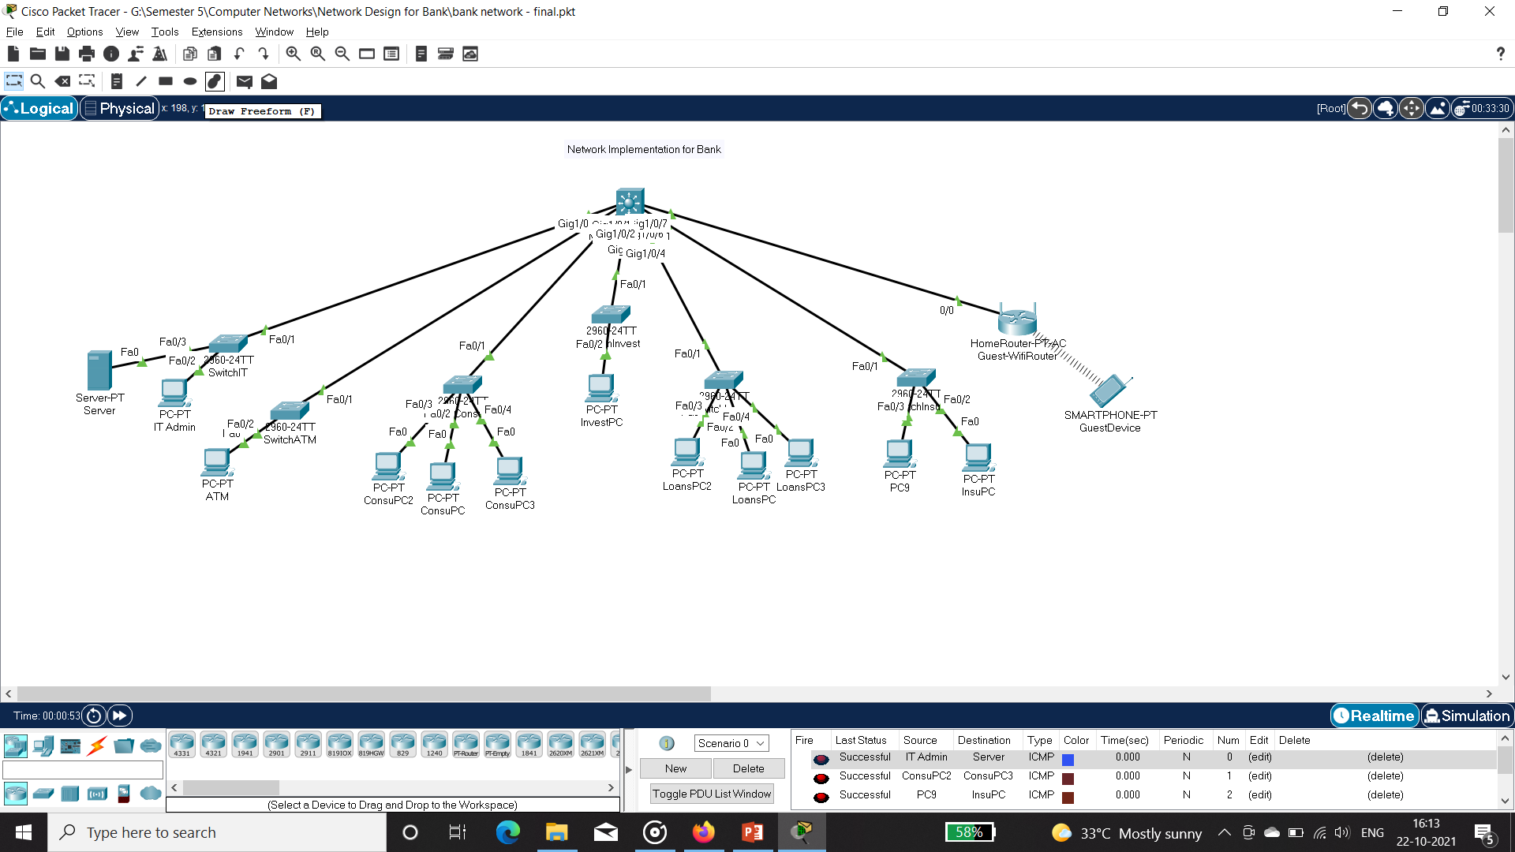
Design Screenshots
Output

Slide 6
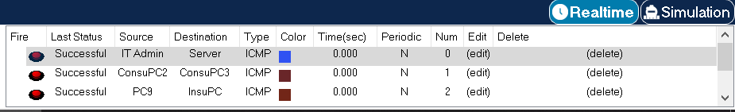
OUTPUT Screenshots
Successful Output

